Slide 1
Class Diagram
Amir Dirin

Slide 2
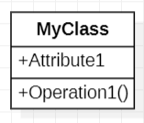
Class Diagram
A class is a description of a set of objects that share the same attributes, operations, relationships, and semantics.
Graphically, a class is rendered as a rectangle, usually including its name, attributes, and operations in separate, designated compartments.

Slide 3
Class Attributes
Attributes can be:
+public
#protected
-private
/derived

Slide 4
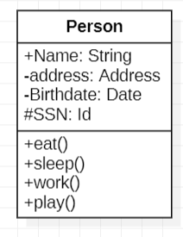
Operations
You can specify an operation by stating its signature: listing the name, type, and default value of all parameters, and, in the case of functions, a return type.

Slide 5
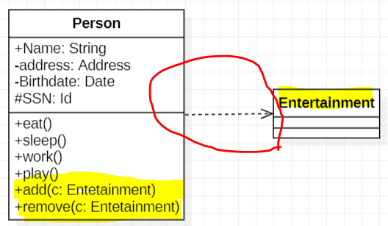

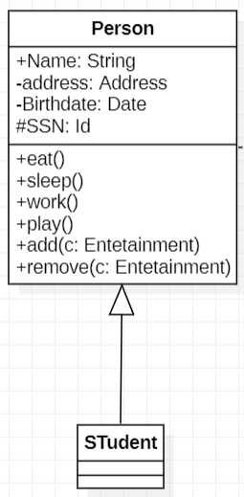
Relationships
In UML , object interaction are modeled as relationships.
Dependencies
Semantic relationship between two or more element
Generalizations
A generalizations connects a subclass to its superclass. It denoted an inheritance of attributes and behavious from superclass

Slide 6
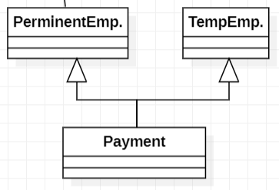

Relationships
Generalization Relationships (Cont’d)
UML permits a class to inherit from multiple supperclass although some programminge.,g java does not allow
Association Relationships
Communication between two classes

Slide 7
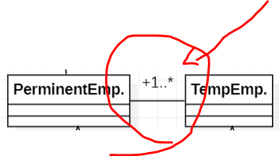
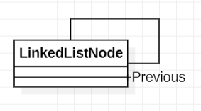
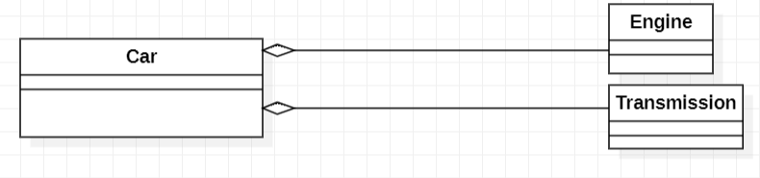
Relationships
Association Relationships
A Class can have a self association
Aggregation
A whole-part relationship between an aggregate and consitutuent part. However, part can exist independently from aggregate.

Slide 8
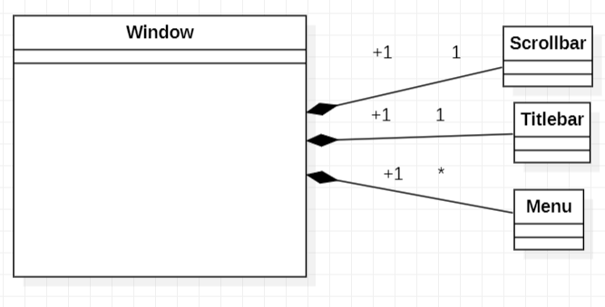
Association Relationships
A composition indicates a strong ownership and coincident lifetime of parts by the whole (i.e., they live and die as a whole). Compositions are denoted by a filled-diamond adornment on the association.

Slide 9
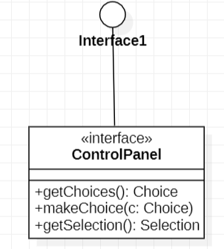
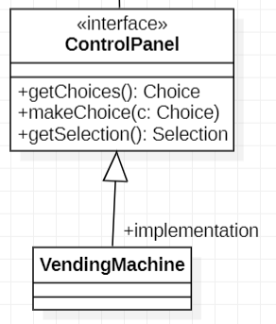
Interface
An interface is a named set of operations that specifies the behaviou of objects without showing their inner structure.

Slide 10
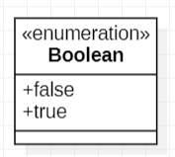
Enumeration
An enumeration is a user-defined data type that consists of a name and and ordered list of enumeration literals.

Slide 11
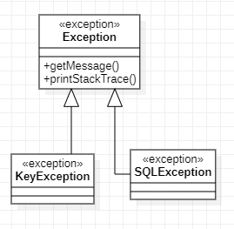
exceptions
Exceptions can be modeled just like any other class.
Notice the <<exception>> stereotype in the name compartment.

Slide 12
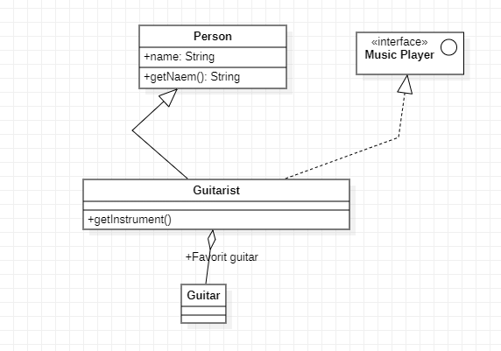
Example
Music Players,
when implemented by guitarist

Slide 13
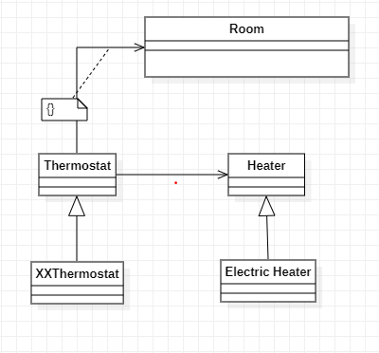
Class Demo
Room, Thermostat, and heaters…

Slide 14
Exercise 1
Draw a UML class diagram that models the relationships between the following classes: Mall (Ostoskeskus), Store (Kauppa), Sales Person (Myyntimies), Department (osasto), Manager (johtaja), Merchandise (tavarat), Store Catalog (katalogi), Store Website (Kaupan Verkkosivu, and Customer (Asiakas).

Slide 15
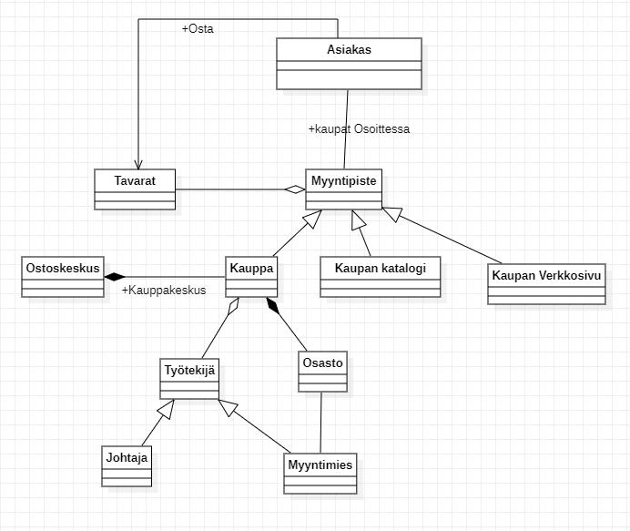
Answer

Slide 16
Home Assignment 2
Draw a UML class diagram that models the relationships between the classes in each of the following lists. Model using aggregation, association, composition and inheritance relationships.
Bank, Savings Account, Loan, Teller, ATM, Customer, Checking Account

